Slide 1

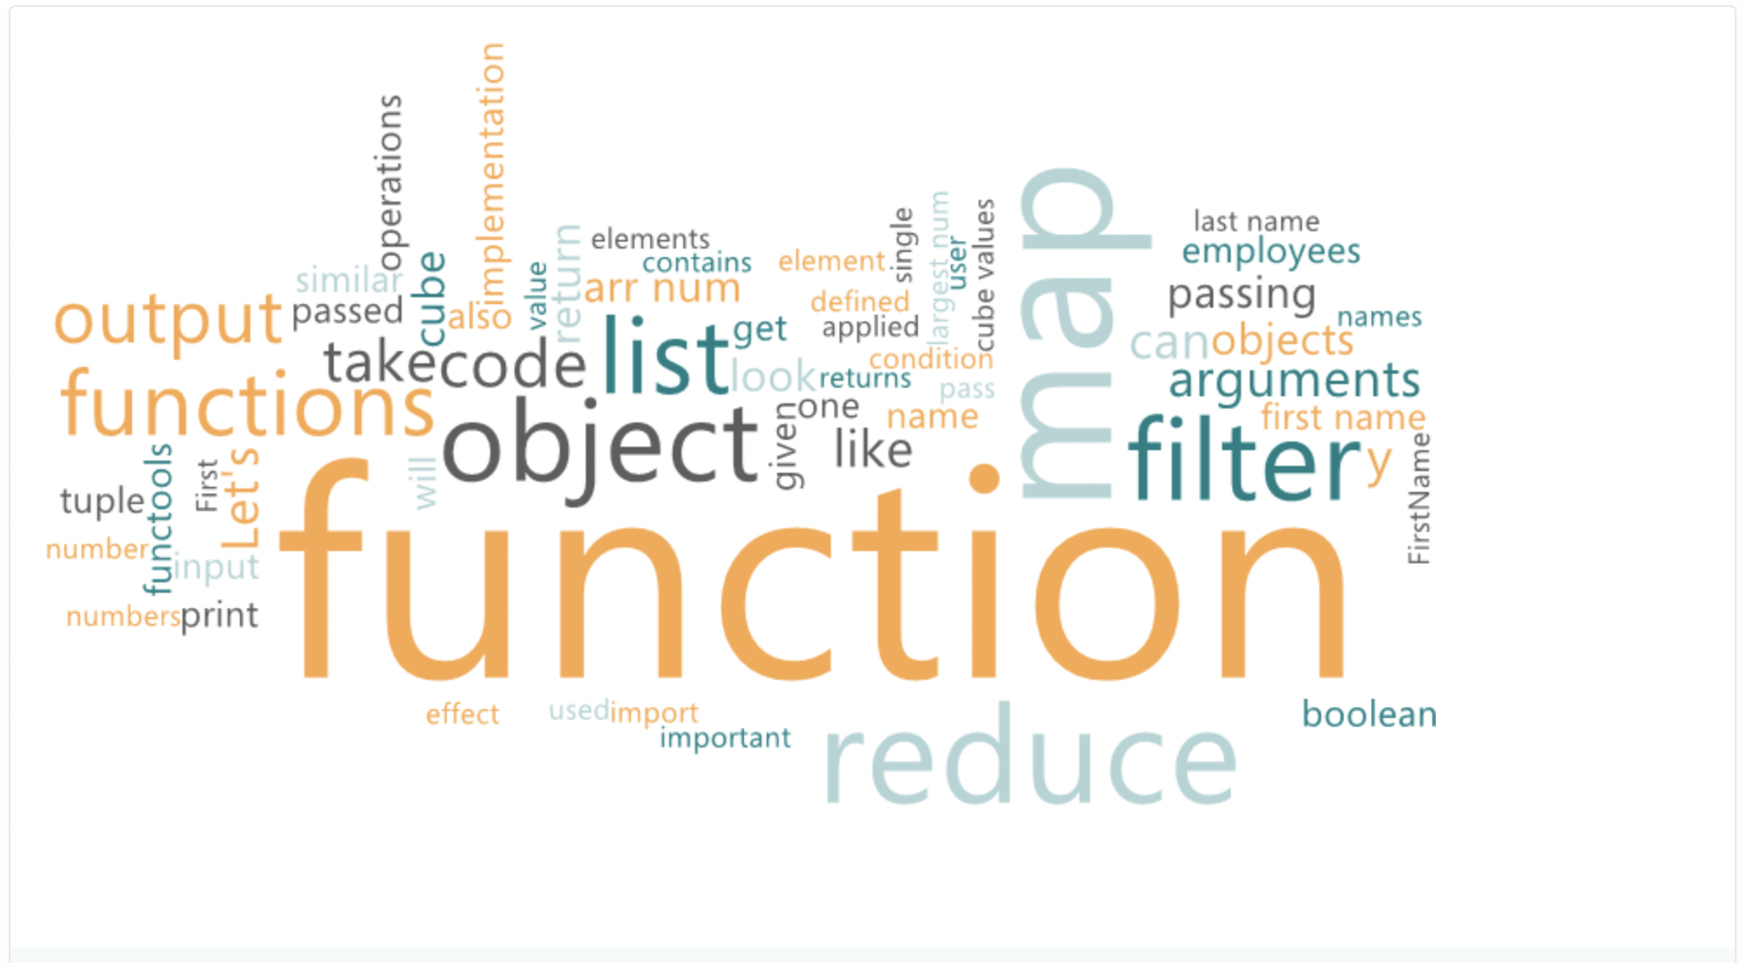
Name of the School: School of computer science and engineering
Course Code:E2UC201C Course Name: Object Oriented Programming
Topic: Functional Programming
Faculty Name: Dr.Karpaga Selvi S

Slide 2
Topics to be covered
Lambda function-First class, higher order and proxy function-Iterators
Performance of Generators: importance and needs of Generators
Decorators: function with parameter and arguments-Class method and static method decorators
Map, Filter, Zip, Reduce,
Regular Expressions
Comprehensions: List, tuples, set and Dictionary
Modules and packages: import packages, built-in modules, package index, pip install, virtual Environments

Slide 3
Introduction
What Is Functional Programming?
Functional programming (FP) is a software development approach centered around the use of pure functions for creating maintainable software.
FP involves building programs through the application and composition of functions.
It leverages language features by treating functions as variables, arguments, and return values, resulting in cleaner and more elegant code.
Immutable data is emphasized, and shared states are avoided, distinguishing it from object-oriented programming (OOP) which often uses mutable data and shared states.
Functional programming languages prioritize declarations and expressions over statement execution.
Functions are treated as first-class citizens, allowing them to be passed as arguments, returned from other functions, and assigned to names.
FP emphasizes focusing on results rather than the process, and does not typically support iterations like loop statements or conditional statements such as If-Else.
Lambda calculus, created by Alonzo Church, studies computations with functions.
It defines computability and is as powerful as Turing machines.
It forms the theoretical basis for modern functional programming languages.

Slide 4
Functional programming in Python
Functional programming in Python involves writing code in a way that emphasizes the use of functions as the primary building blocks of programs. Here's how it's typically approached:
Pure Functions: Functions in functional programming should ideally be pure, meaning they have no side effects and produce the same output for the same input every time they're called.
Immutable Data: Data structures are preferably immutable, meaning they cannot be changed after they're created. This encourages a more declarative style of programming.
Higher-order Functions: Functions can be treated as first-class citizens, meaning they can be passed as arguments to other functions, returned from functions, and assigned to variables.
Recursion: Instead of using iterative constructs like loops, functional programming often utilizes recursion to perform repetitive tasks.
List Comprehensions and Functional Constructs: Python provides features like list comprehensions, generator expressions, map(), filter(), and reduce() functions, which are commonly used in functional programming paradigms.
Avoiding Mutable State: Functional programming discourages the use of mutable state and encourages immutable objects and data transformations.
Lazy Evaluation: Lazy evaluation techniques, like generators, allow for more efficient memory usage by computing values only when needed.

Slide 5
Functional programming in Python
.
Functional programming involves executing computations by combining functions that accept arguments and return specific values as output. These functions adhere to the principles of immutability, meaning they do not alter their input arguments or modify the program's state. Instead, they solely provide the result of a given computation, earning them the designation of pure functions.
In practice, adopting a functional programming approach can streamline various aspects of software development:
Development: By enabling developers to code and utilize each function independently, functional programming facilitates modular and isolated development.
Debugging and Testing: Functional programming simplifies debugging and testing processes since individual functions can be tested and debugged without needing to consider the entire program's context.
Understanding: As functional programming avoids state changes throughout the program, it enhances code comprehension by eliminating the need to track and manage state alterations.

Slide 6
LAMBDA FUNCTION
lambda function
Small anonymous function (Function without name)
Take any number of arguments, but can only have one expression
Syntax
lambda arguments : Expression
Example
funct = lambda a : a+10
print(funct(4))

Slide 7
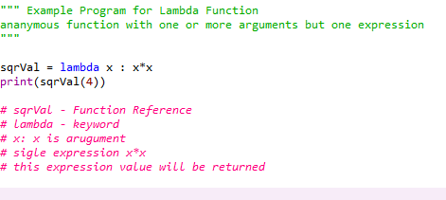
Lambda function example – one argument
sqrVal = lambda x : x*x
print(sqrVal(4))
# sqrVal - Function Reference
# lambda - keyword
# x: x is arugument
# sigle expression x*x
# this expression value will be returned

Slide 8
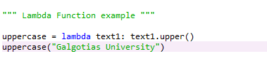
Lambda Function example

Slide 9
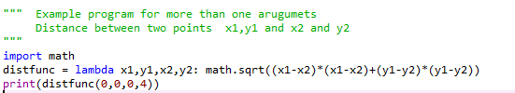
Lambda Function Two arguments - Example

Slide 10
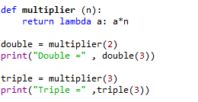
Why Use Lambda Functions?
The power of lambda is better shown when you use them as an anonymous function inside another function
Multiplier(2) = returns function (lamba a:a*2) and saved in variable double
double(3) executes function (lamba a:a*2) where argument a = 3

Slide 11
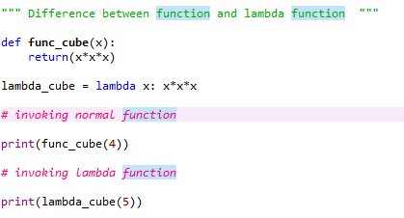

Slide 12
Difference Between Lambda functions and def defined function
With lambda function | Without lambda function
Supports single-line sometimes statements that return some value. | Supports any number of lines inside a function block
Good for performing short operations/data manipulations. | Good for any cases that require multiple lines of code.
Using the lambda function can sometime reduce the readability of code. | We can use comments and function descriptions for easy readability.

Slide 13
First class Functions in Python
A programming language is said to support first-class functions if it treats functions as first-class objects. Python supports the concept of First Class functions.
Properties of first class functions:
A function is an instance of the Object type.
You can store the function in a variable.
You can pass the function as a parameter to another function.
You can return the function from a function.
You can store them in data structures such as hash tables, lists, …

Slide 14
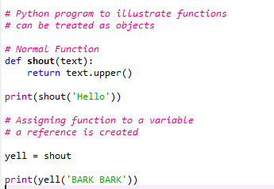
Functions as objects
In Python, a function can be assigned to a variable.
This assignment does not call the function, instead a reference to that function is created.

Slide 15
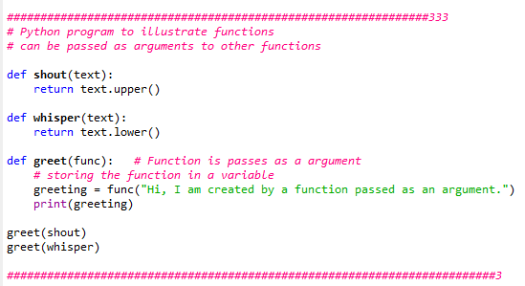
Function as parameter
Functions can be passed to other functions in python like objects

Slide 16
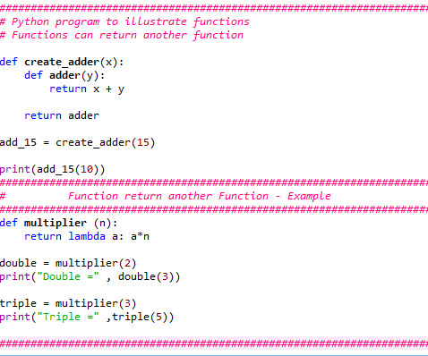
Returning a function

Slide 17
Higher Order function
Higher Order Functions in Python
A function is called Higher Order Function if it contains other functions as a parameter or returns a function as an output
Functions that operate with another function are known as Higher order Functions
A function that receives another function as an argument or that returns a new function or both is called Higher-order function. Higher-order functions are only possible because of the First-class function.

Slide 18
Iterator
Iterators are objects that can be iterated upon (can traverse through all the values)
An iterator is an object which implements the iterator protocol, which consist of the methods __iter__() and __next__()
Iterator vs Iterable
Lists, tuples, dictionaries, and sets are all iterable objects. They are iterable containers which you can get an iterator from.
All these objects have a iter() method which is used to get an iterator:

Slide 19
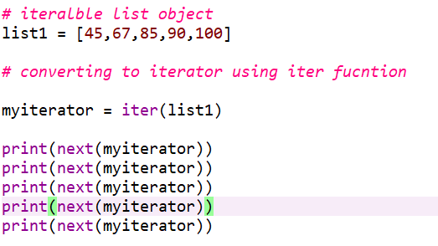
Iterator

Slide 20
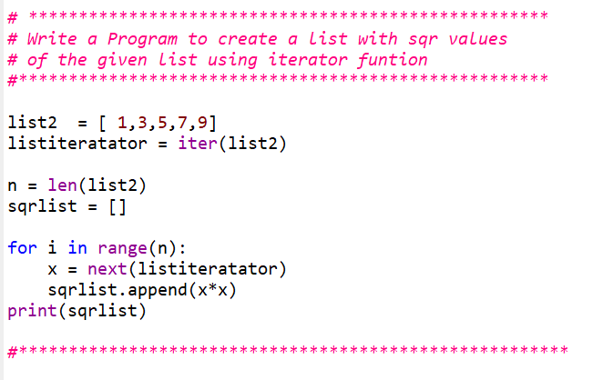
Iterator

Slide 21
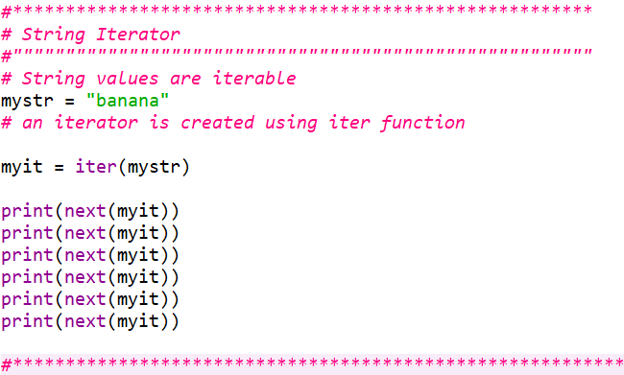

Slide 22
Create Iterator
To create an object/class as an iterator you have to implement the methods __iter__() and __next__() to your object.
As you have learned in the Python Classes/Objects chapter, all classes have a function called __init__(), which allows you to do some initializing when the object is being created.
The __iter__() method acts similar, you can do operations (initializing etc.), but must always return the iterator object itself.
The __next__() method also allows you to do operations, and must return the next item in the sequence.

Slide 23
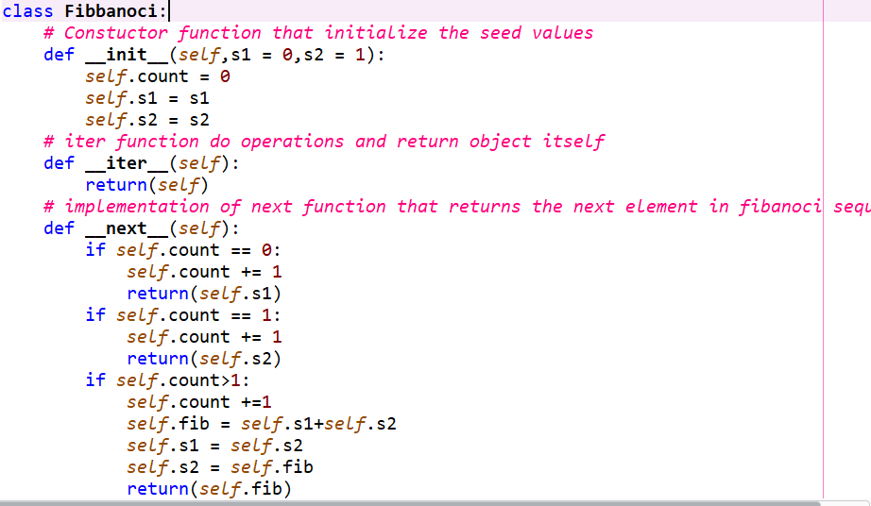
Iterator

Slide 24
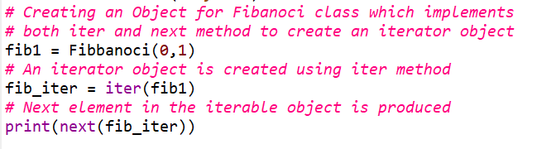
Iterator

Slide 25
Iterator
To prevent the iteration from going on forever, we can use the StopIteration statement.
In the __next__() method, we can add a terminating condition to raise an error if the iteration is done a specified number of times:

Slide 26
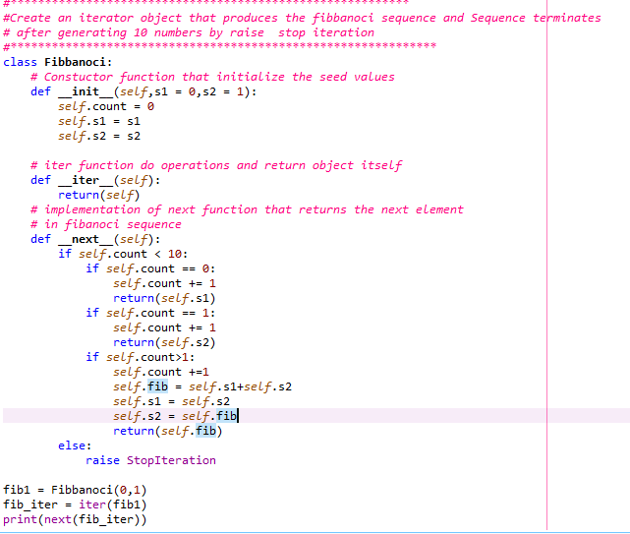

Slide 27
Generator
Alternative to implementing an iterator is to use a generator
Generators looks similar to Python functions does not return items.
Generators uses the yield keyword to generate items on the fly.
Generator is a special kind of function that leverages lazy evaluation
Generators do not store their contents in memory as you would expect a typical iterable to do.

Slide 28
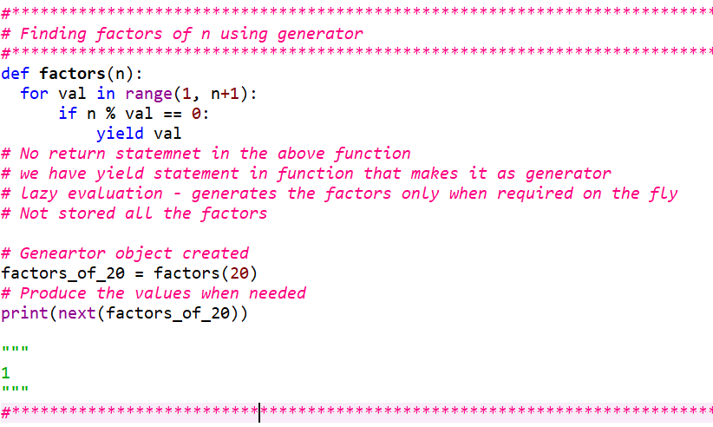
Generators

Slide 29
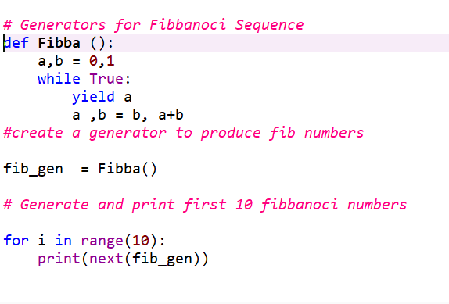

Slide 30
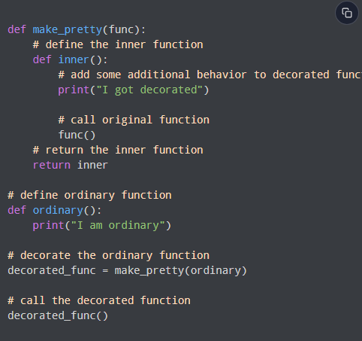
Decorators
A Python decorator is a function that takes in a function and returns it by adding some functionality.

Slide 31
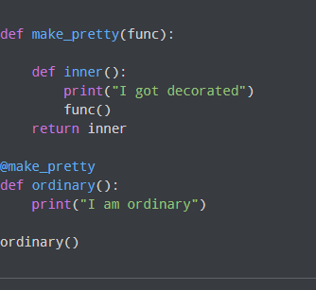
Decorator
@ Symbol With Decorator
Instead of assigning the function call to a variable, Python provides a much more elegant way to achieve this functionality using the @ symbol

Slide 32
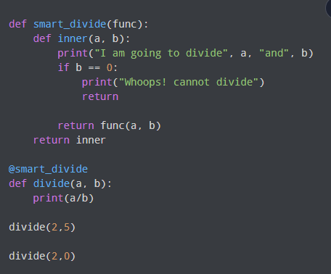
Decorator Function for Division

Slide 33
Map, Filter, and Reduce.
The core principles of functional programming revolve around three fundamental functions: Map, Filter, and Reduce.
These functions operate by passing functions as arguments to other functions, enabling seamless operation within functional programming paradigms.
One crucial aspect of these functions is their purity, ensuring that they consistently produce the same output for a given set of inputs, thus minimizing the likelihood of bugs arising from variable changes, user inputs, or unintended consequences.
Below is a concise summary outlining the key characteristics of Map, Reduce, and Filter, emphasizing the impact of the function passed as an argument and the input's influence on the output.

Slide 34
Map, Filter, and Reduce.
Functional programming commonly employs data structures such as lists, arrays, and iterables alongside a collection of functions designed to manipulate and transform this data. When processing data in a functional style, three primary techniques are frequently employed:
Mapping: This involves applying a transformation function to an iterable, generating a new iterable where each item is the result of applying the transformation function to the corresponding item in the original iterable.
Filtering: Filtering entails applying a predicate or Boolean function to an iterable to generate a new iterable. The resulting iterable contains only those items from the original iterable that satisfy the predicate function.
Reducing: Reduction involves applying a reduction function to an iterable to produce a single cumulative value, often aggregating or summarizing the elements of the iterable into a compact result.

Slide 35
map() function in python
map() function returns a map object(which is an iterator) of the results after applying the given function to each item of a given iterable (list, tuple etc.)
Python map() Function Syntax
Syntax: map(fun, iter)
Parameters:
fun: It is a function to which map passes each element of given iterable.
iter: It is iterable which is to be mapped. (list, tuple)
NOTE: You can pass one or more iterable to the map() function
Returns: Returns a list of the results after applying the given function to each item of a given iterable (list, tuple etc.)
NOTE : The returned value from map() (map object) then can be passed to functions like list() (to create a list), set() (to create a set) .

Slide 36
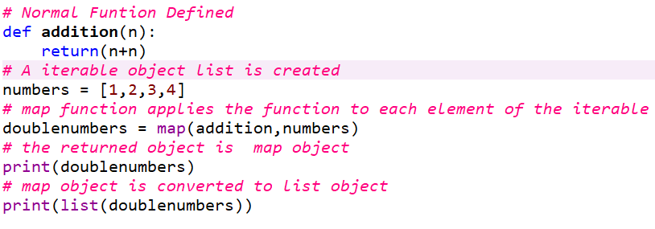
Map() function – illustration Program

Slide 37
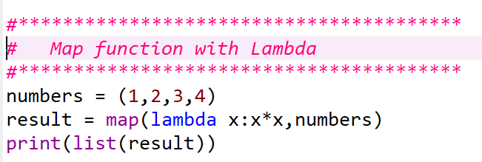
Map() function with Lambda

Slide 38
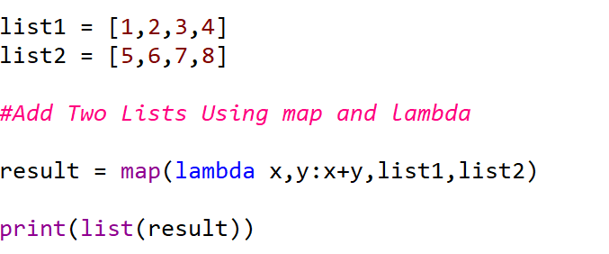
map function with more than one iterable objects
The function parameter can be any Python function that accepts a number of arguments equal to the number of iterables passed to `map()`.

Slide 39
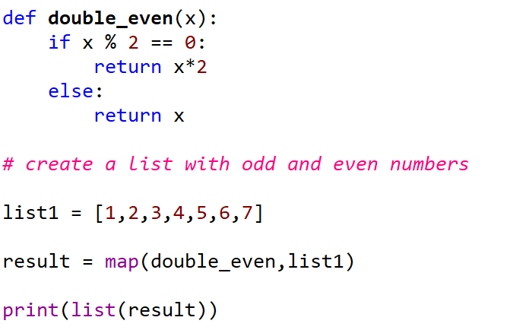
Exercise
Write a python Program that doubles even numbers in a list and keep odd numbers as such using map function

Slide 40
Map- Advantages
Utilizing `map()` offers several advantages.
map()` is implemented in C and is highly optimized,
its internal implicit loop may exhibit greater efficiency compared to a conventional Python for loop, enhancing performance.
Regarding memory consumption, employing a for loop necessitates storing the entire list in the system's memory. Conversely, with `map()`, items are retrieved on demand, ensuring that only one item occupies the system's memory at any given time. This feature can lead to more efficient memory usage when working with large datasets.

Slide 41
Filter Function - Use a filter function to exclude items in an iterable object
Definition and Usage
The filter() function returns an iterator where the items are filtered through a function to test if the item is accepted or not.
Syntax
filter(function, iterable)
Parameter | Description
function | A Function to be run for each item in the iterable
iterable | The iterable to be filtered

Slide 42
Filter function
"function," must be a single-argument function
The first argument for `filter()` should be a function object (meaning you pass a function without parentheses.)
Predicate function returning True or False based on a condition
This function acts as a decision or filtering function, determining which values to keep in the resulting iterable by filtering out those evaluated as False

Slide 43
Filter Function
The second argument, `iterable`, accepts any Python iterable like lists, tuples, or sets, including generator and iterator objects. `filter()` exclusively accepts one iterable.
`filter()` iterates over every item in the iterable, applying the function in a loop.
It returns an iterator yielding values for which the function returns true.
Importantly, this process doesn't alter the original iterable.
As `filter()` is optimized in C, its internal loop can be more efficient than a regular for loop, enhancing execution time. This efficiency is a key advantage of using `filter()` in Python.
Moreover, `filter()` returns a filter object, which is an iterator providing values on demand, supporting a lazy evaluation approach. This iterator-based mechanism enhances memory efficiency compared to an equivalent for loop.

Slide 44
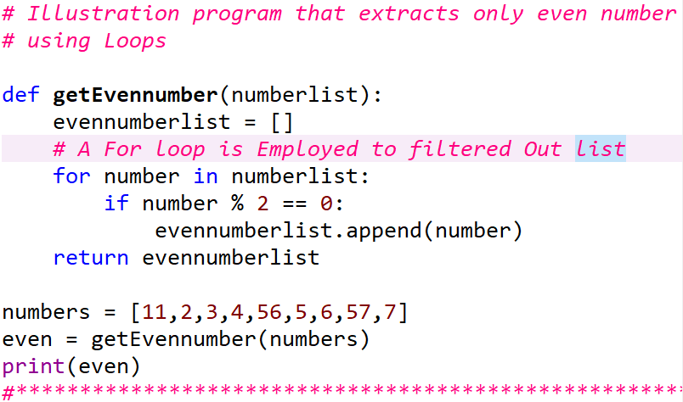
Program that filters even numbers using loops

Slide 45
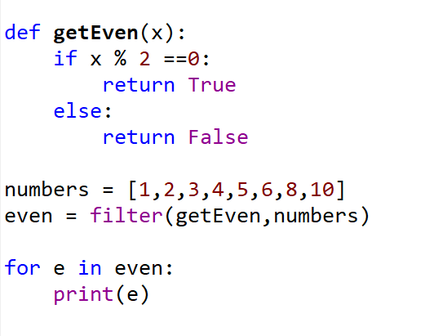
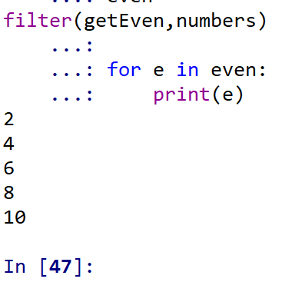
Illustration Program – Filtering odd numbers

Slide 46
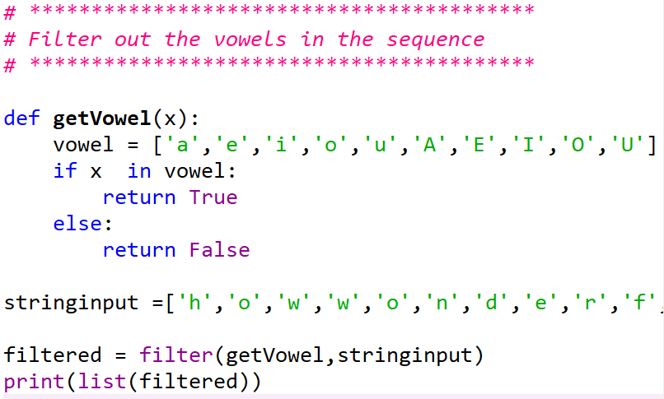

Slide 47
Filter with Lambda
Typically filter()` function is paired with lambda functions.
Use a lambda function to separate odd and even numbers from a list using filter.

Slide 48
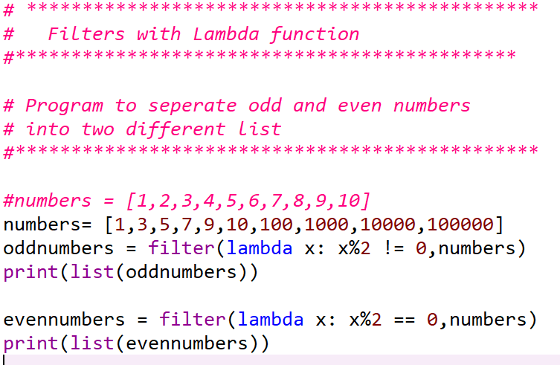

Slide 49
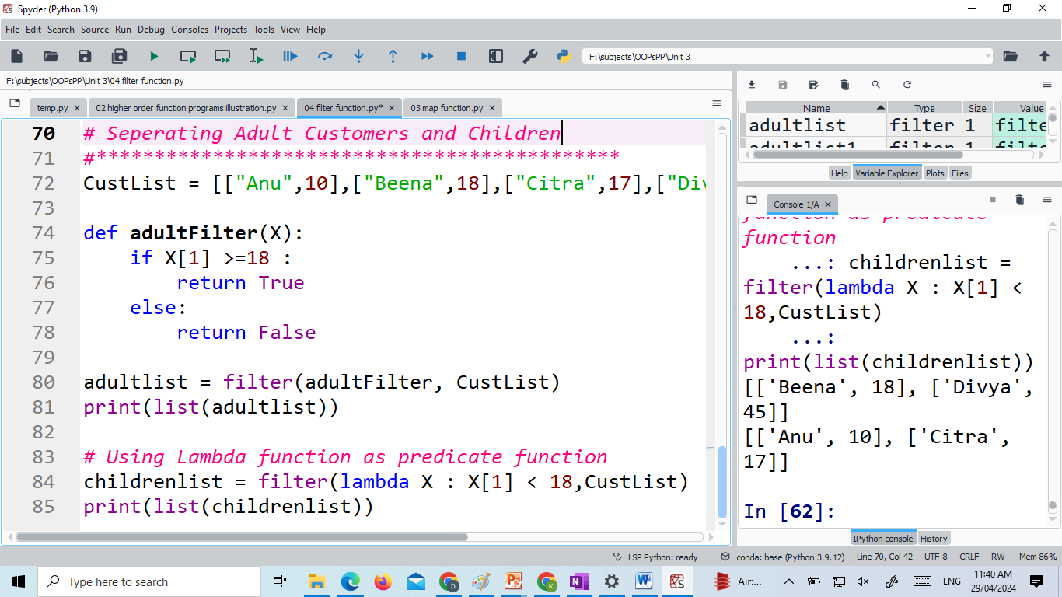

Slide 50

Reduce in python
reduce() in Python
In Python, the `reduce()` function is built-in and applies a specified function to the elements of an iterable, condensing them into a single value.
The syntax for `reduce()` is:
The `function` argument represents a function accepting two arguments and producing a single value. The first argument denotes the accumulated value, while the second denotes the current value from the iterable.
The `iterable` argument signifies the sequence of values to be condensed.
The optional `initializer` argument furnishes an initial value for the accumulated result. If omitted, the first element of the iterable serves as the initial value.

Slide 51
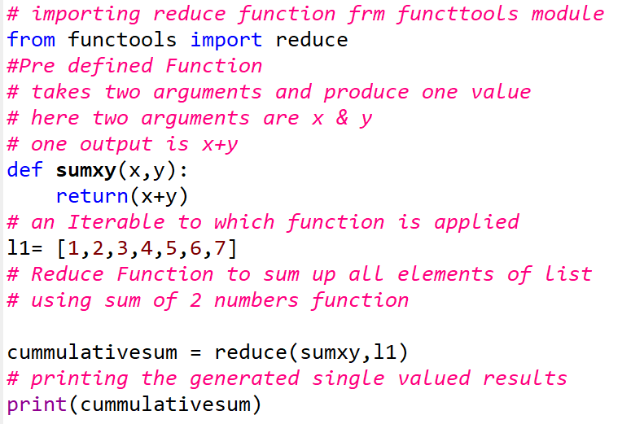
Reduce in python Example Program
Here's an example that demonstrates how to use reduce() to find the sum of a list of numbers:

Slide 52
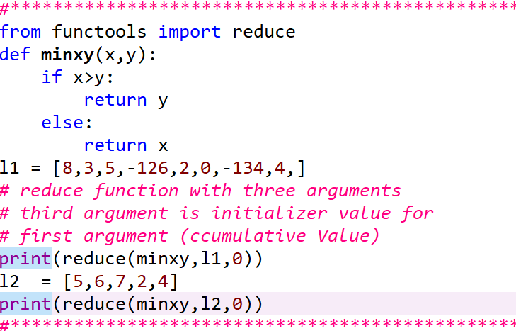
Reduce function to find minimum numbe in a list of Numbers
Let us use third argument of the reduce() function:

Slide 53
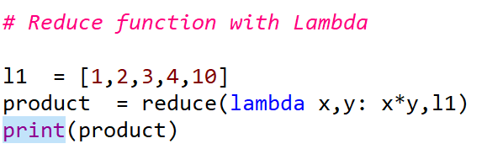
Reduce.

Slide 54
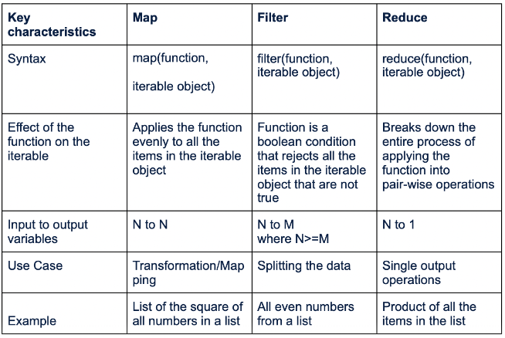
Map, Filter, and Reduce.

Slide 55
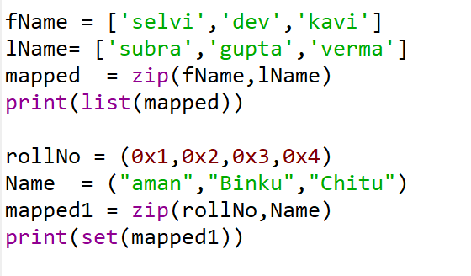
Zip
In functional programming in Python, the `zip()` function is often used to combine multiple iterables element-wise into tuples. It takes two or more iterables as input and returns an iterator of tuples, where each tuple contains the corresponding elements from the input iterables.
Here's an example:
Output
In functional programming, `zip()` is commonly used with other functional constructs like `map()` or list comprehensions to perform operations on multiple iterables simultaneously. This allows for a more concise and expressive way to manipulate data in a functional style.

Slide 56
Zip – Usage Illustration
# Python code to demonstrate the application of
# zip()
# initializing list of players.
players = ["Sachin", "Sehwag", "Gambhir", "Dravid", "Raina"]
# initializing their scores
scores = [100, 15, 17, 28, 43]
# printing players and scores.
for pl, sc in zip(players, scores):
print("Player : %s Score : %d" % (pl, sc))

Slide 57
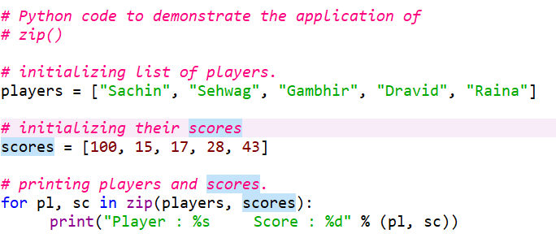

Slide 58
Pure Functions
A pure function adheres strictly to the principle that its output is solely determined by its input, devoid of any observable side effects. In functional programming, programs consist entirely of the evaluation of pure functions. Computation progresses through nested or composed function calls, without altering state or mutable data.
The functional paradigm enjoys popularity due to its numerous advantages over other programming paradigms. Functional code exhibits the following characteristics:
1. High-level: Descriptions of desired results take precedence over explicit steps needed to achieve them. Single statements are often succinct yet impactful.
2. Transparent: The behavior of a pure function relies solely on its inputs and outputs, excluding any intermediary values. This absence of side effects simplifies debugging.
3. Parallelizable: Functions devoid of side effects can be executed more readily in parallel with each other, enhancing efficiency in concurrent operations.

Slide 59
Pure Functions
To support functional programming, it's advantageous for a programming language to enable functions to:
1. Accept other functions as arguments.
2. Return functions to their caller.
Python excels in both these regards. As covered previously, Python treats everything in a program as an object, with functions being no exception.

Slide 60
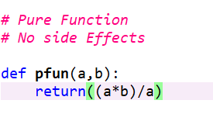
Pure Functions
In functional programming in Python, pure functions are functions that:
Always return the same output for the same input.
Have no side effects, meaning they do not modify any external state or variables.
Here's an example of a pure function in Python:
This function takes two inputs, `a` and `b`, and returns their sum. It will always return the same result for the same inputs, and it does not modify any external state. Therefore, it is considered a pure function.
In functional programming, pure functions are favored because they are easier to reason about, test, and compose. They also help in writing more predictable and maintainable code.

Slide 61
Impure Function
An impure function is a function that has side effects or does not always return the same output when given the same input. Side effects can include
Modifying a global variable
Changing the state of an object
Functions that generate Random output
Functions receive user inputs

Slide 62
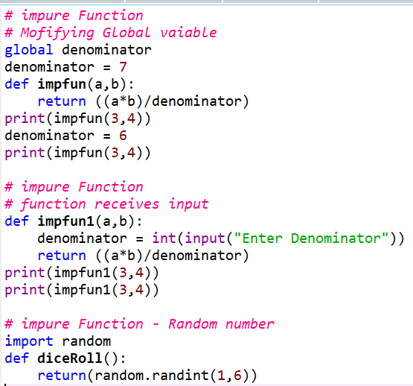

Slide 63
Decorators
Decorators represent a potent and valuable tool in Python, empowering programmers to alter the behavior of a function or class dynamically. They enable the wrapping of one function to extend its behavior, all without permanently altering its core functionality. However, before delving into decorators, it's beneficial to grasp some fundamental concepts that will aid in comprehending decorators effectively.
In Python, functions are regarded as first-class objects, embodying several key properties:
1. Instance of Object Type: Functions are instances of the Object type, possessing the same attributes as any other object in Python.
2. Storable in Variables: Functions can be stored in variables, enabling flexible usage and manipulation.

Slide 64
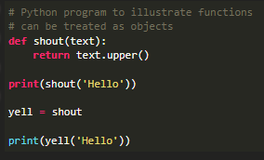

Decorators
3. Passable as Parameters: Functions can be passed as parameters to other functions, facilitating dynamic behavior and higher-order functions.
4. Returnable from Functions: Functions can be returned as results from other functions, allowing for dynamic creation and composition of functions.
5. Storable in Data Structures: Functions can be stored within various data structures such as hash tables, lists, and more, permitting efficient organization and retrieval.
Consider the following examples to gain a clearer understanding of these concepts.
Output

Slide 65
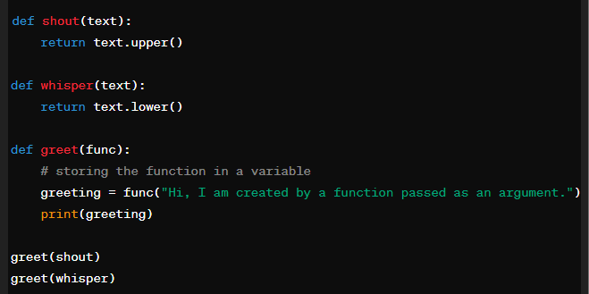
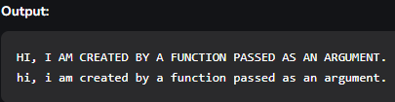
Decorators
Example 2: Passing the function as an argument
In the above example, the greet function takes another function as a parameter (shout and whisper in this case). The function passed as an argument is then called inside the function greet.

Slide 66
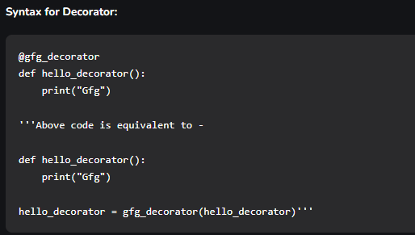
Decorators
As stated above the decorators are used to modify the behaviour of function or class. In Decorators, functions are taken as the argument into another function and then called inside the wrapper function.
In the provided code, `gfg_decorator` is a callable function designed to augment another callable function, `hello_decorator`, by adding additional functionality to it. It returns a wrapper function encapsulating both the original function and the added code.

Slide 67
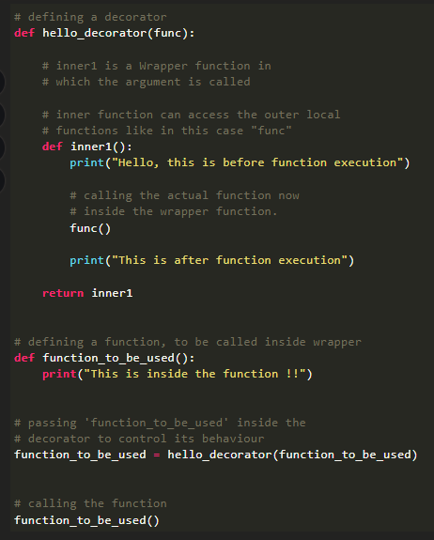
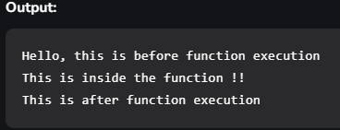
Decorator can modify behaviour

Slide 68
Decorators importance and needs
In functional programming, decorators play a significant role in enhancing code readability, maintainability, and reusability by allowing for the dynamic modification or extension of functions or methods. In Python, decorators are higher-order functions that take another function as input and return a new function that typically extends or modifies the behavior of the original function.
Here's a detailed exploration of the importance and need of decorators in functional programming, with reference to Python:
1. Separation of Concerns: Decorators enable the separation of concerns by allowing developers to add cross-cutting concerns (such as logging, authentication, caching, etc.) to functions without modifying their core logic. This promotes a cleaner and more modular codebase.
2. Code Reusability: Decorators promote code reusability by encapsulating reusable functionality within decorator functions. This enables developers to apply the same functionality to multiple functions or methods throughout their codebase without duplicating code.
3. Readability: Decorators enhance code readability by clearly delineating the additional functionality applied to a function. By decorating a function with a descriptive decorator name, developers can easily understand and reason about the behavior of the function.

Slide 69
Decorators importance and needs
4. Dynamic Behavior: Decorators enable dynamic behavior by allowing functions to be modified or extended at runtime. This enables developers to adapt the behavior of functions based on specific requirements or conditions, enhancing the flexibility of the codebase.
5. Aspect-Oriented Programming (AOP): Decorators facilitate aspect-oriented programming by providing a mechanism to separate cross-cutting concerns from the core logic of functions. This promotes cleaner and more modular code architecture, making it easier to maintain and evolve large codebases.
6. Promoting Functional Paradigm: Decorators align with the functional programming paradigm by treating functions as first-class citizens and enabling higher-order functions. They encourage the use of pure functions and immutable data structures, promoting functional programming principles within Python codebases.
In Python, decorators are commonly used in frameworks and libraries for tasks such as request handling in web applications (e.g., Flask, Django), method caching (e.g., functools.lru_cache), logging, authentication, and authorization. They provide a powerful mechanism for extending and enhancing the behavior of functions in a flexible and reusable manner, making them indispensable tools in the Python ecosystem for functional programming.

Slide 70
Generators, Regular expressions and Comprehensions
Generators, regular expressions, and comprehensions are essential tools in Python programming, particularly within the context of functional programming. Let's delve into each of these concepts in detail:
Generators:
Generators are a powerful feature in Python that allow for the creation of iterators. They provide a convenient way to generate a sequence of values lazily, on-the-fly, rather than storing them in memory all at once. This is especially useful when dealing with large datasets or infinite sequences.
In functional programming, generators fit well with the principle of lazy evaluation, where computations are deferred until their results are actually needed. They enable the creation of functions that produce a stream of values, allowing for efficient memory usage and improved performance.
Generators are defined using the `yield` keyword, which suspends the function's execution and returns a value to the caller. The function's state is preserved, allowing it to resume execution from where it left off when called again.

Slide 71
Generators, Regular expressions and Comprehensions
Performance of Generators:
Generators offer several performance benefits:
1. Memory Efficiency: Since generators produce values on-the-fly, they do not store the entire sequence in memory at once. This makes them suitable for processing large datasets or infinite sequences without exhausting system resources.
2. Time Efficiency: Generators allow for lazy evaluation, meaning computations are only performed when values are actually needed. This can lead to significant time savings, especially when dealing with complex or resource-intensive operations.
3. Optimized Iteration: Generators provide an optimized way to iterate over sequences, reducing the overhead associated with creating and managing intermediate data structures.
4. Concise and Readable Code: Generators enable the encapsulation of complex logic or data generation into a single function, leading to more concise and readable code. This enhances code maintainability and comprehension.
5. Enhanced Code Reusability: Generator functions can be reused across different parts of the codebase. This allows for the encapsulation of common functionality or data generation logic, promoting code reusability and reducing redundancy.

Slide 72
Generators, Regular expressions and Comprehensions
6. Suitability for Large Datasets: Generators excel in handling large datasets that cannot fit into memory. By generating data on-the-fly and iterating over it one piece at a time, generators minimize memory usage and optimize performance.
7. Performance Optimization: Generators are instrumental in performance optimization, especially when dealing with large datasets. By avoiding the need to store all data in memory simultaneously, generators reduce memory overhead and improve overall performance.
Python generators find utility in various real-world scenarios:
1. Processing Large Datasets: Generators excel at handling large datasets, like reading from sizable CSV files or processing database query results. By iterating over data incrementally, generators minimize memory usage and boost performance.
2. Parsing and Processing Complex Files: When parsing large XML or JSON files, generators facilitate incremental processing, ideal for handling files too large to fit in memory or for processing streaming data efficiently.

Slide 73
Generators, Regular expressions and Comprehensions
3. Web Scraping: In web scraping tasks, generators efficiently process extensive data from websites. By fetching web pages one at a time and parsing HTML incrementally, generators streamline data extraction.
4. Log File Analysis: Generators efficiently process large log files by reading entries one at a time, enabling filtering or transformation of data without overwhelming memory resources.
5. Data Stream Processing: Real-time data streams, like those from sensors or IoT devices, benefit from generators for incremental processing, ensuring efficient and timely data analysis.
6. Image Processing: Image processing tasks leverage generators to handle large numbers of images or video frames efficiently. By processing images one at a time, memory usage is optimized.
7. Data Analysis and Machine Learning: Generators aid in processing vast datasets, such as machine learning training data, in smaller, manageable chunks. This improves memory management and processing efficiency.
8. Network Communication: Generators are instrumental in network communication tasks, allowing for the sequential processing of incoming data packets, enhancing memory usage and performance.

Slide 74
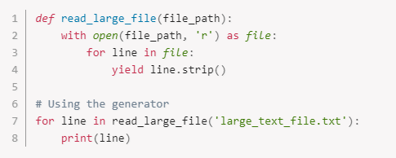
Generators, Regular expressions and Comprehensions
Consider the following example of a generator that reads lines from a sizable text file:
In this example, the read_large_file generator reads lines from a large text file one at a time, allowing you to process the file line by line without loading the entire file into memory.

Slide 75
Generators, Regular expressions and Comprehensions
Regular Expressions:
Regular expressions (regex) are a powerful tool for pattern matching and text manipulation. They allow developers to search for specific patterns within strings, extract data, and perform sophisticated text transformations.
In functional programming, regular expressions are commonly used for data processing tasks such as parsing, validation, and extraction. They enable developers to write concise and expressive code for pattern-based operations.
Python's `re` module provides comprehensive support for regular expressions, allowing developers to compile regex patterns, search for matches within strings, and perform various text manipulation operations.
A Python regular expression is a sequence of metacharacters that define a search pattern. We use these patterns in a string-searching algorithm to "find" or "find and replace" on strings.
The term "regular expressions" is frequently shortened to "RegEx".

Slide 76
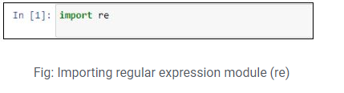
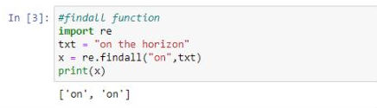
Generators, Regular expressions and Comprehensions
RegEx Functions
The “re” module provides a set of functions that enables us to search a string for a match. Some of the functions are listed below:
findall() function
The findall() function returns a list containing all matches.

Slide 77
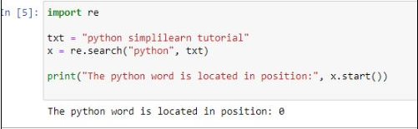
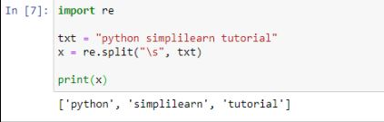
Generators, Regular expressions and Comprehensions
search() function
The search() function takes a regular expression pattern and a string, and it searches for that pattern within the string. If the search is successful, search() returns a match object. Otherwise, it doesn’t return any.
split() function
The split() function returns a list that shows where the string has been split at each match.

Slide 78
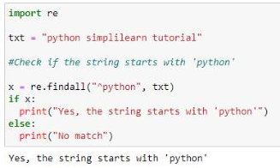

Generators, Regular expressions and Comprehensions
Python RegEx: Metacharacters
Every character in a Python RegEx is either a metacharacter or a regular character. A metacharacter has a special meaning, whereas a regular character matches itself.
Some of the basic metacharacters used in RegEx include:
“^”
The ‘ ^ ’ character checks if the string starts with a particular word or character
“$”
The ‘$‘ character checks if the string ends with a particular word or character.
.

Slide 79


Generators, Regular expressions and Comprehensions
“|”
The ‘ | ‘ character is used to check either/or condition.
“+”
This matches one or more occurrences of a character in a
string.

Slide 80

Generators, Regular expressions and Comprehensions
“*”
This returns the zero or more occurrences of a character
in a string.
Comprehensions:
Comprehensions are a concise and expressive way to create collections (lists, dictionaries, sets) in Python. They allow developers to generate collections by applying an expression to each element of an iterable, often in a single line of code.
In functional programming, comprehensions align well with the principles of declarative programming, where computations are expressed in terms of transformations on data structures.

Slide 81
Generators, Regular expressions and Comprehensions
Python supports several types of comprehensions:
- List Comprehensions: Generate lists by applying an expression to each element of an iterable.
- Dictionary Comprehensions: Generate dictionaries by applying key-value expressions to each element of an iterable.
- Set Comprehensions: Generate sets by applying an expression to each element of an iterable.
Comprehensions offer performance benefits by leveraging optimized internal mechanisms for iteration and collection creation, resulting in more efficient code execution.
1. List Comprehensions:
List comprehensions provide a concise and expressive way to create lists in Python by applying an expression to each element of an iterable. The syntax is [expression for item in iterable if condition].

Slide 82



Generators, Regular expressions and Comprehensions
Here's an example of a list comprehension that generates a list of squares of numbers from 0 to 9:
In this example:
x**2 is the expression applied to each element.
for x in range(10) iterates over numbers from 0 to 9.
There's no condition in this example, so all elements from the iterable are included.

Slide 83



Generators, Regular expressions and Comprehensions
Dictionary Comprehensions:
Dictionary comprehensions allow you to create dictionaries by applying key-value expressions to each element of an iterable. The syntax is {key_expression: value_expression for item in iterable if condition}.
Here's an example that creates a dictionary mapping numbers to their squares:
In this example:
x: x**2 is the key-value expression.
for x in range(1, 6) iterates over numbers from 1 to 5.
There's no condition, so all elements from the iterable are included.

Slide 84



Generators, Regular expressions and Comprehensions
Set Comprehensions:
Set comprehensions provide a concise way to create sets in Python by applying an expression to each element of an iterable. The syntax is {expression for item in iterable if condition}.
Here's an example that generates a set of the first five squares of even numbers:
In this example:
x**2 is the expression applied to each element.
for x in range(10) if x % 2 == 0 iterates over even numbers from 0 to 9.
Only even squares are included in the set, filtered by the condition if x % 2 == 0.

Slide 85



Generators, Regular expressions and Comprehensions
Tuple Comprehensions:
In Python, tuples do not have a direct comprehension syntax like lists, dictionaries, and sets. Tuples are immutable, meaning once created, their elements cannot be changed or modified. However, tuple comprehensions can be simulated using generator expressions along with the tuple() constructor.
Here's how you can create a tuple comprehension using generator expressions:
This code simulates a tuple comprehension using a generator expression `(x**2 for x in range(5))`, which yields the squares of numbers from 0 to 4. The `tuple()` constructor converts the generator expression into a tuple, maintaining its immutability.
While tuple comprehensions lack a dedicated syntax like lists or sets, they achieve the same result effectively. They are useful for creating tuples from expressions applied to iterable elements, but their application may be more limited due to tuples' immutability.

Slide 86

Modules and Packages
Modules and packages are fundamental concepts in Python that facilitate code organization, reuse, and distribution. They play a crucial role in functional programming by promoting modularity, abstraction, and code separation.
Modules:
A module is a file containing Python code, typically containing functions, classes, and variables, that can be imported and used in other Python scripts. Modules allow for better organization of code by grouping related functionality together. They help avoid naming conflicts and promote code reusability.

Slide 87

Modules and Packages
Packages:
A package is a directory containing one or more Python modules and an __init__.py file (which can be empty). Packages provide a hierarchical structure for organizing modules and sub-packages. They allow for the creation of larger, more complex libraries and applications.
Example:
Importance in Functional Programming:
In functional programming, modules and packages play crucial roles in structuring and organizing code, promoting modularity, reusability, and maintainability. Here's why they are important in the context of functional programming:
Modularity: Functional programming emphasizes breaking down programs into smaller, composable functions.

Slide 88
Modules and Packages
Modules and packages provide a way to organize these functions into logical units. Each module can focus on a specific aspect of the program, making the codebase easier to understand and maintain.
Encapsulation: Modules allow you to encapsulate related functions and data structures, hiding implementation details and exposing only the necessary interfaces. This promotes information hiding and reduces coupling between different parts of the program, leading to more robust and scalable code.
Reusability: By organizing functions into modules and packages, you can easily reuse them across different parts of your program or even in other projects. This promotes code reuse, which is a key principle in functional programming, as it allows you to leverage existing code and avoid reinventing the wheel.
Namespace Management: Modules provide a namespace for functions and variables, preventing naming conflicts and enabling better organization of code. This is particularly important in functional programming, where functions are first-class citizens and can be passed around as arguments or returned from other functions.

Slide 89
Modules and Packages
Separation of Concerns: Modules and packages help in separating different concerns or layers of your application, such as input/output, business logic, and presentation. This separation makes the codebase easier to reason about, test, and maintain, as each module focuses on a specific aspect of the application.
Testing and Debugging: Modular code is easier to test and debug, as you can isolate and test individual modules independently of each other. This promotes a more systematic approach to testing and helps in identifying and fixing bugs more efficiently.
Scalability: As your codebase grows, modular design becomes increasingly important for managing complexity and maintaining productivity. Modules and packages provide a scalable structure for organizing and evolving your codebase over time.
Overall, modules and packages are essential building blocks in functional programming, enabling you to write more modular, reusable, and maintainable code. They facilitate the principles of modularity, encapsulation, and code reuse, which are central to the functional programming paradigm.

Slide 90



Modules and Packages
Implementation with Example:
Let's create a simple package named my_package with a module mymodule:
Contents of mymodule.py:
Contents of __init__.py (can be empty):

Slide 91


Modules and Packages
To import and use the greet function from mymodule:
Different Methods of Importing Packages:
Importing Specific Functions or Variables:

Slide 92


Modules and Packages
2. Importing the Entire Module:
3. Using Alias for Modules:

Slide 93

Modules and Packages
Built-in Modules:
Built-in modules in Python are modules that come pre-installed with the Python interpreter. These modules provide a wide range of functionality for tasks such as file I/O, mathematics, working with dates and times, and much more.
lets see some examples of built-in modules along with brief explanations and examples of how they can be used:
1. math: This module provides mathematical functions and constants.

Slide 94


Modules and Packages
2. random: This module provides functions for generating random numbers and shuffling sequences.
3. datetime: This module provides classes for working with dates and times.

Slide 95
Modules and Packages
Other built-in modules
os: Interface with the operating system, including file operations.
sys: System-specific parameters and functions.
json: Encoding and decoding JSON data.
re: Regular expression operations.
csv: Reading and writing CSV files.
collections: Additional data structures beyond the built-in ones.
itertools: Functions for creating iterators for efficient looping.
functools: Higher-order functions and operations on callable objects.
pickle: Serialization and deserialization of Python objects.
subprocess: Spawn new processes, connect to their input/output/error pipes, and obtain their return codes.

Slide 96

Difference between module and package

Slide 97
Package Index and Pip Install:
The Python Package Index (PyPI) is a repository of software packages for Python. pip is a package management system used to install and manage Python packages from PyPI.
A package index, often referred to as a package repository or package index server, is a centralized location where Python packages are hosted and made available for installation. The most commonly used package index for Python is the Python Package Index (PyPI), which can be found at https://pypi.org/. PyPI hosts thousands of Python packages, including libraries, frameworks, and tools, contributed by the Python community.
Package Index (PyPI):
PyPI serves as a centralized repository for Python packages.
Package authors upload their packages to PyPI, making them publicly available for others to install and use.
Each package on PyPI has its own page containing information about the package, such as its name, version, description, and dependencies.

Slide 98

Package Index and Pip Install:
pip:
pip is the default package manager for Python. It is a command-line tool used to install, upgrade, and manage Python packages.
pip interacts with the Python Package Index (PyPI) to download and install packages.
It resolves dependencies automatically, installing any required packages that a package depends on.
pip also provides options for specifying the version of a package to install, upgrading packages, uninstalling packages, and more.
pip install:
pip install is the command used to install Python packages from PyPI.
You typically run pip install followed by the name of the package you want to install. For example:
This command installs the requests package, which is commonly used for making HTTP requests in Python.

Slide 99

Package Index and Pip Install:
You can also specify a specific version of a package to install. For example:
This command installs version 2.26.0 of the requests package.
pip install automatically resolves dependencies and installs them along with the requested package.
Using pip install along with the package index (PyPI) is the most common way to install Python packages and manage dependencies in Python projects. It provides a convenient and standardized way to access a vast ecosystem of Python libraries and tools.

Slide 100
Virtual Environments
A Python Virtual Environment is an isolated space where you can work on your Python projects, separately from your system-installed Python.
You can set up your own libraries and dependencies without affecting the system Python.
We will use virtualenv to create a virtual environment in Python.
What is a Virtual Environment?
A virtual environment is a tool that helps to keep dependencies required by different projects separate by creating isolated Python virtual environments for them. This is one of the most important tools that most Python developers use.

Slide 101
Virtual Environments
Why do we need a virtual environment?
Consider a scenario where you're managing two web-based Python projects: one relying on Django 4.0 and the other on Django 4.1 (or the latest versions). In such cases, employing a virtual environment in Python proves indispensable. It aids in segregating dependencies for each project, ensuring clean and isolated environments for development and maintenance
When and where to use a virtual environment?
It's essential to employ a virtual environment whenever you're engaged in Python-based projects. By default, projects share the same directories for storing and accessing third-party libraries, leading to potential conflicts, especially with different versions of libraries like Django.
To address this issue, virtual environments offer a solution by creating isolated environments for each project. This segregation prevents version clashes and ensures that dependencies are contained within their respective environments.

Slide 102
Virtual Environments
The beauty of virtual environments lies in their flexibility. You can create as many environments as needed, as they simply consist of directories containing a few scripts.
In summary, adopting a virtual environment for every Python-based project is advisable. This practice ensures that project dependencies remain isolated from both the system and other projects, minimizing compatibility issues and facilitating smoother development workflows.
Create Virtual Environment in Python
To establish a virtual environment in Python, we utilize a module called virtualenv. This tool enables the creation of isolated environments separate from the system environment's Python setup.
When virtualenv is employed, it generates a directory housing all essential executables required for utilizing packages essential to a Python project.

Slide 103



Virtual Environments
To install virtualenv:
Test your installation:
Create a new Virtual Environment
You can create a virtualenv using the following command:
After running this command, a directory named my_env will be created. This is the directory that contains all the necessary executables to use the packages that a Python project would need.
This is where Python packages will be installed. If you want to specify the Python interpreter of your choice, for example, Python 3, it can be done using the following command:

Slide 104

Virtual Environments
Activating a Virtual Environment in Python
Now after creating a virtual environment, you need to activate it. Remember to activate the relevant virtual environment every time you work on the project. This can be done using the following command:
Activate a Virtual Environment on Windows
To activate virtual environment using windows command prompt change directory to your virtual env, Then use the below command
$ cd <envname>
$ Scripts\activate

Slide 105


Virtual Environments
Installing Dependencies in Virtual Environment Python
In the image below, venv named virtual environment is active. Now you can install dependencies related to the project in this virtual environment.
For example, if you are using Django 1.9 for a project, you can install it like you install other packages.
The Django 1.9 package will be placed in virtualenv_name folder and will be isolated from the complete system.
Deactivate Python Virtual Environment
Once you are done with the work, you can deactivate the virtual environment by the following command:

Slide 106
Virtual Environments
In short,
A virtual environment in Python is an isolated environment where project-specific dependencies can be installed and managed separately from the system-wide Python environment. It ensures that each project has its own set of dependencies without conflicts between different projects or the system environment. This enhances dependency management, facilitates version control, and ensures reproducibility across different environments.

